Slide 1

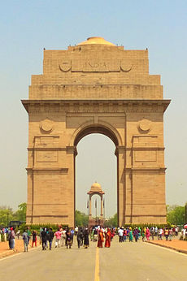
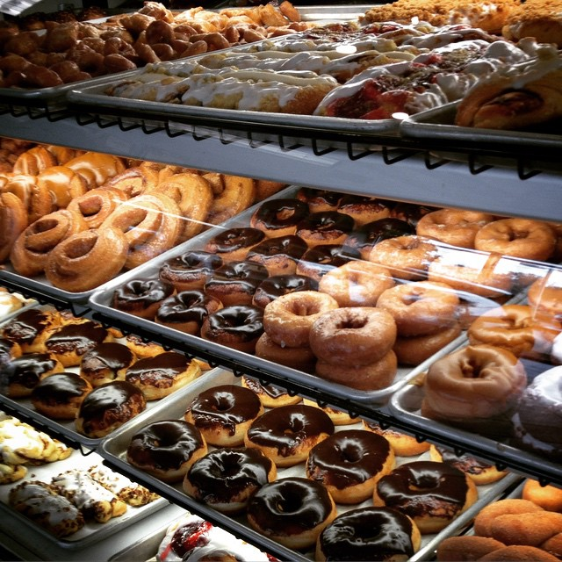
Coursera Capstone
IBM Applied Data Science Capstone
Opening a new Bakery in Delhi, India
By: Vaishnavi Gupta
July 2020

Slide 2
INTRODUCTION
For many people, bakeries are a good place to get the best and exotic delicacies from. With the improving lifestyle of people, many prefer to opt for good bakeries to satisfy their tummies and with the arrival of new delicacies and sweets from across the world, opening a bakery store has its own brilliant financial returns.
Baking enthusiasts are keener than ever to tap this growing market that has more demand now than ever before.
Opening bakeries allows property developers to earn rental income as well.
The location of the bakery is one of the most important decisions that will determine whether it will be a success or a failure.

Slide 3
Business Problem
Objective: To analyse and select the best locations in the city of Delhi, India to open a new bakery.
Target Audience of this project
This project is particularly useful to help baking enthusiasts who are willing to take further steps in establishing their bakery.
Now that more and more people are looking forward to taking up something that aligns with their passion, this project becomes even more important.

Slide 4
DATA
To solve the problem, we will need the following data:
List of neighbourhoods in Delhi.
Latitude and longitude coordinates of those neighbourhoods.
Venue data, particularly data related to bakeries.
Sources of data and methods to extract them:
This Wikipedia page https://en.wikipedia.org/wiki/Category:Neighbourhoods_in_Delhi
We will use web scraping techniques to extract the data from the Wikipedia page, with the help of Python requests and beautifulsoup packages.
using Python Geocoder package to get the latitude and longitude coordinates of the neighbourhoods.

Slide 5
METHODOLOGY
Firstly, we need to get the list of neighbourhoods in the city of Delhi. Fortunately, the list is available in the Wikipedia page (https://en.wikipedia.org/wiki/Category:Neighbourhoods_in_Delhi). For this we use pandas library.
Next, we will use Foursquare API to get the top 100 venues that are within a radius of 2000 meters. Foursquare will return the venue data in JSON format and we will extract the venue name, venue category, venue latitude and longitude.
Then, we will analyse each neighbourhood by grouping the rows by neighbourhood and taking the mean of the frequency of occurrence of each venue category.

Slide 6
By doing so, we are also preparing the data for use in clustering. Since we are analysing the “Bakery” data, we will filter the “Bakery” as venue category for the neighbourhoods.
Lastly, we will perform clustering on the data by using k-means clustering. We will cluster the neighbourhoods into 3 clusters based on their frequency of occurrence for “Bakery”.
The results will allow us to identify which neighbourhoods have higher concentration of bakeries and which neighbourhoods have fewer number of bakeries.
Based on the occurrence of bakeries in different neighbourhoods, it will help us to answer the question as to which neighbourhoods are most suitable to open new bakeries.

Slide 7

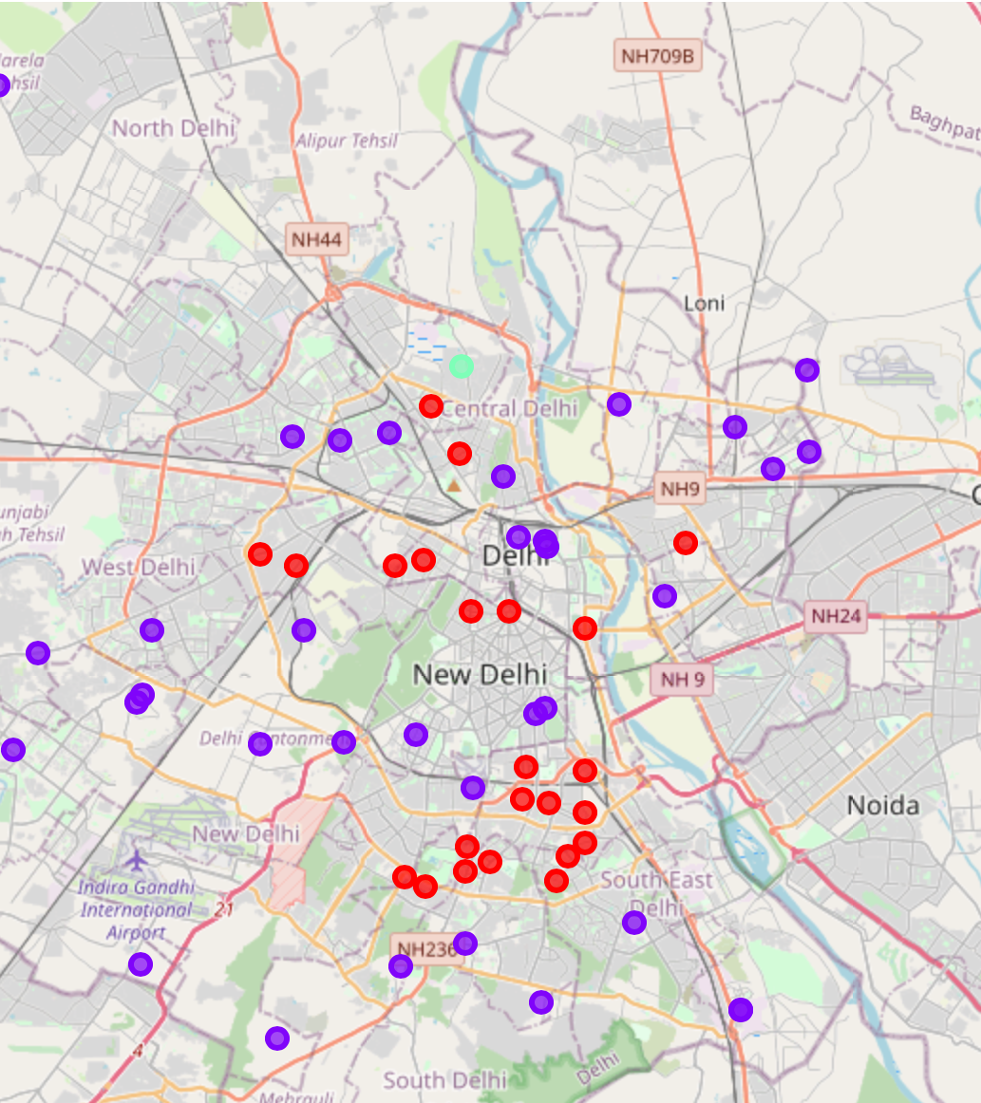
RESULTS
Cluster 0: Neighbourhoods with moderate number of bakeries
Cluster 1: Neighbourhoods with low number to no existence of bakeries
Cluster 2: Neighbourhoods with high concentration of bakeries
The results of the clustering are visualized in the map with cluster 0 in red colour, cluster 1 in purple colour, and cluster 2 in mint green colour.

Slide 8
DISCUSSION
Most of the bakeries are concentrated in the central area of Delhi, with the highest number in cluster 2 and moderate number in cluster 0.
On the other hand, cluster 1 has very low number of bakeries in the neighbourhoods.
Bakeries can also stand out from the competition if they have new items to offer in neighbourhoods in cluster 0 with moderate competition.
Lastly, developers are advised to avoid neighbourhoods in cluster 2 which already have high concentration of bakeries and suffering from intense competition.

Slide 9
Suggestions
Cluster 1 is best suited for a new bakery.
Cluster 0 can be used to open a new bakery with moderate competition, and it can stand out if the owner has some special dishes or offers.
Cluster 2 should be avoided as it has high competition and can hit the revenue generation.
Other factors such as family income, rent of a shop and culture of the place shall be kept in mind for further study.

Slide 10

CONCLUSION
In this project, we have gone through the process of identifying the business problem, specifying the data required, extracting and preparing the data, performing machine learning by clustering the data into 3 clusters based on their similarities, and lastly providing recommendations to the relevant stakeholders i.e. bakery enthusiasts to open a new bakery.
To answer the business question that was raised in the introduction section, the answer proposed by this project is: The neighbourhoods in cluster 1 are the most preferred locations to open a new bakery.
The findings of this project will help the relevant stakeholders to capitalize on the opportunities on high potential locations while avoiding overcrowded areas in their decisions to open a new bakery.

Slide 11

REFERENCES
Category: Neighbourhoods in Delhi. Wikipedia. Retrieved from https://en.wikipedia.org/wiki/Category:Neighbourhoods_in_Delhi
Foursquare Developers Documentation. Foursquare. Retrieved from https://developer.foursquare.com/docs

